Slide 1



Jakarta RESTful Web Services 3.1 Workshop
COPYRIGHT (C) 2023, ECLIPSE FOUNDATION. | THIS WORK IS LICENSED UNDER A CREATIVE COMMONS ATTRIBUTION 4.0 INTERNATIONAL LICENSE (CC BY 4.0)

Slide 2
Workshop Modules
Module 1
Set up the environment
Module 2
Coding the task that will become a service.
Module 3
SeBootstrap web service implementation
GET
Module 4
Server based web service implementation
GET
Module 5
Java SE desktop client
GET
Module 6
Servlet and Jakarta Faces application server client
POST
Module 7
MultiPart File Upload
Module 8
JPA service

Slide 3
Jakarta RESTful Web Services 3.1 Workshop Module 1
Prepared for the Eclipse Foundation
Clone: [???????????????]

Slide 4
How does a Jakarta.ws.rs work?
REST Client
REST Server
Request: GET, POST, PUT, DELETE
Java SE
Console
Swing
JavaFX
Jakarta EE
Servlet
Faces (JSF)
JSP
Embedded Server
Jersey
RESTEasy
App Server
GlassFish
Payara
& others
Response
Request
A REST client in any language
Response

Slide 5
The Tool Box
Java SE 17
Jakarta versions are tied to a Java LTS version.
Jakarta 10 supports Java 17
Build tool
Maven
Use the most recent version
IDE
Not required but convenient
Must support Jakarta EE coding
Application Server
Any Jakarta 10 compliant server can work
Workshop uses GlassFish 7
Database
Any DB with a JDBC driver can be used
Workshop uses Derby that is included with GlassFish
Basic Service Testing Tool
cURL for CLI testing of services

Slide 6
Maven
All the projects in this workshop use Maven
Ensure that the Maven command line tool, mvn, is on your path
The pom files include a <defaultGoal>
This means that to build and sometimes run a project all you need do is open a terminal or console in a project’s root folder and enter mvn
No Maven switches are required
In some modules you will need to deploy the code to GlassFish

Slide 7
Important
Read the participant documents, these will tell you what is expected from you
Read the source code, pom files, and other XML files
All are commented and contain additional information

Slide 8
Jakarta RESTful Web Services 3.1 Workshop Module 2
Coding the task that will become a service.

Slide 9
Your Task
The workshop requires a task that can be used as a RESTful web service
You are free to create any task
Avoid complexity and create a task in a POJO and, if needed, one DTO, typically coded as a JavaBean
There is no need for your task to have a UI as the methods will be called by the RESTful web services

Slide 10
The Task - Compound Interest Calculation
If you would like to use our task look at mod_02_compoundinterest_participant
This project contains the class CompoundInterest.java with two methods to complete
public void calculateCompoundInterest(CompoundBean compoundBean)
private boolean validateBean(CompoundBean compoundBean)
There is also a JUnit5 parameterized test class that is complete:
ParameterizedTests.java
If you use our task, then ensure that it can pass the unit tests

Slide 11
Jakarta RESTful Web Services 3.1 Workshop Module 3
Java SE standalone RESTful web service using the Jakarta EE 10 SeBootstrap class

Slide 12
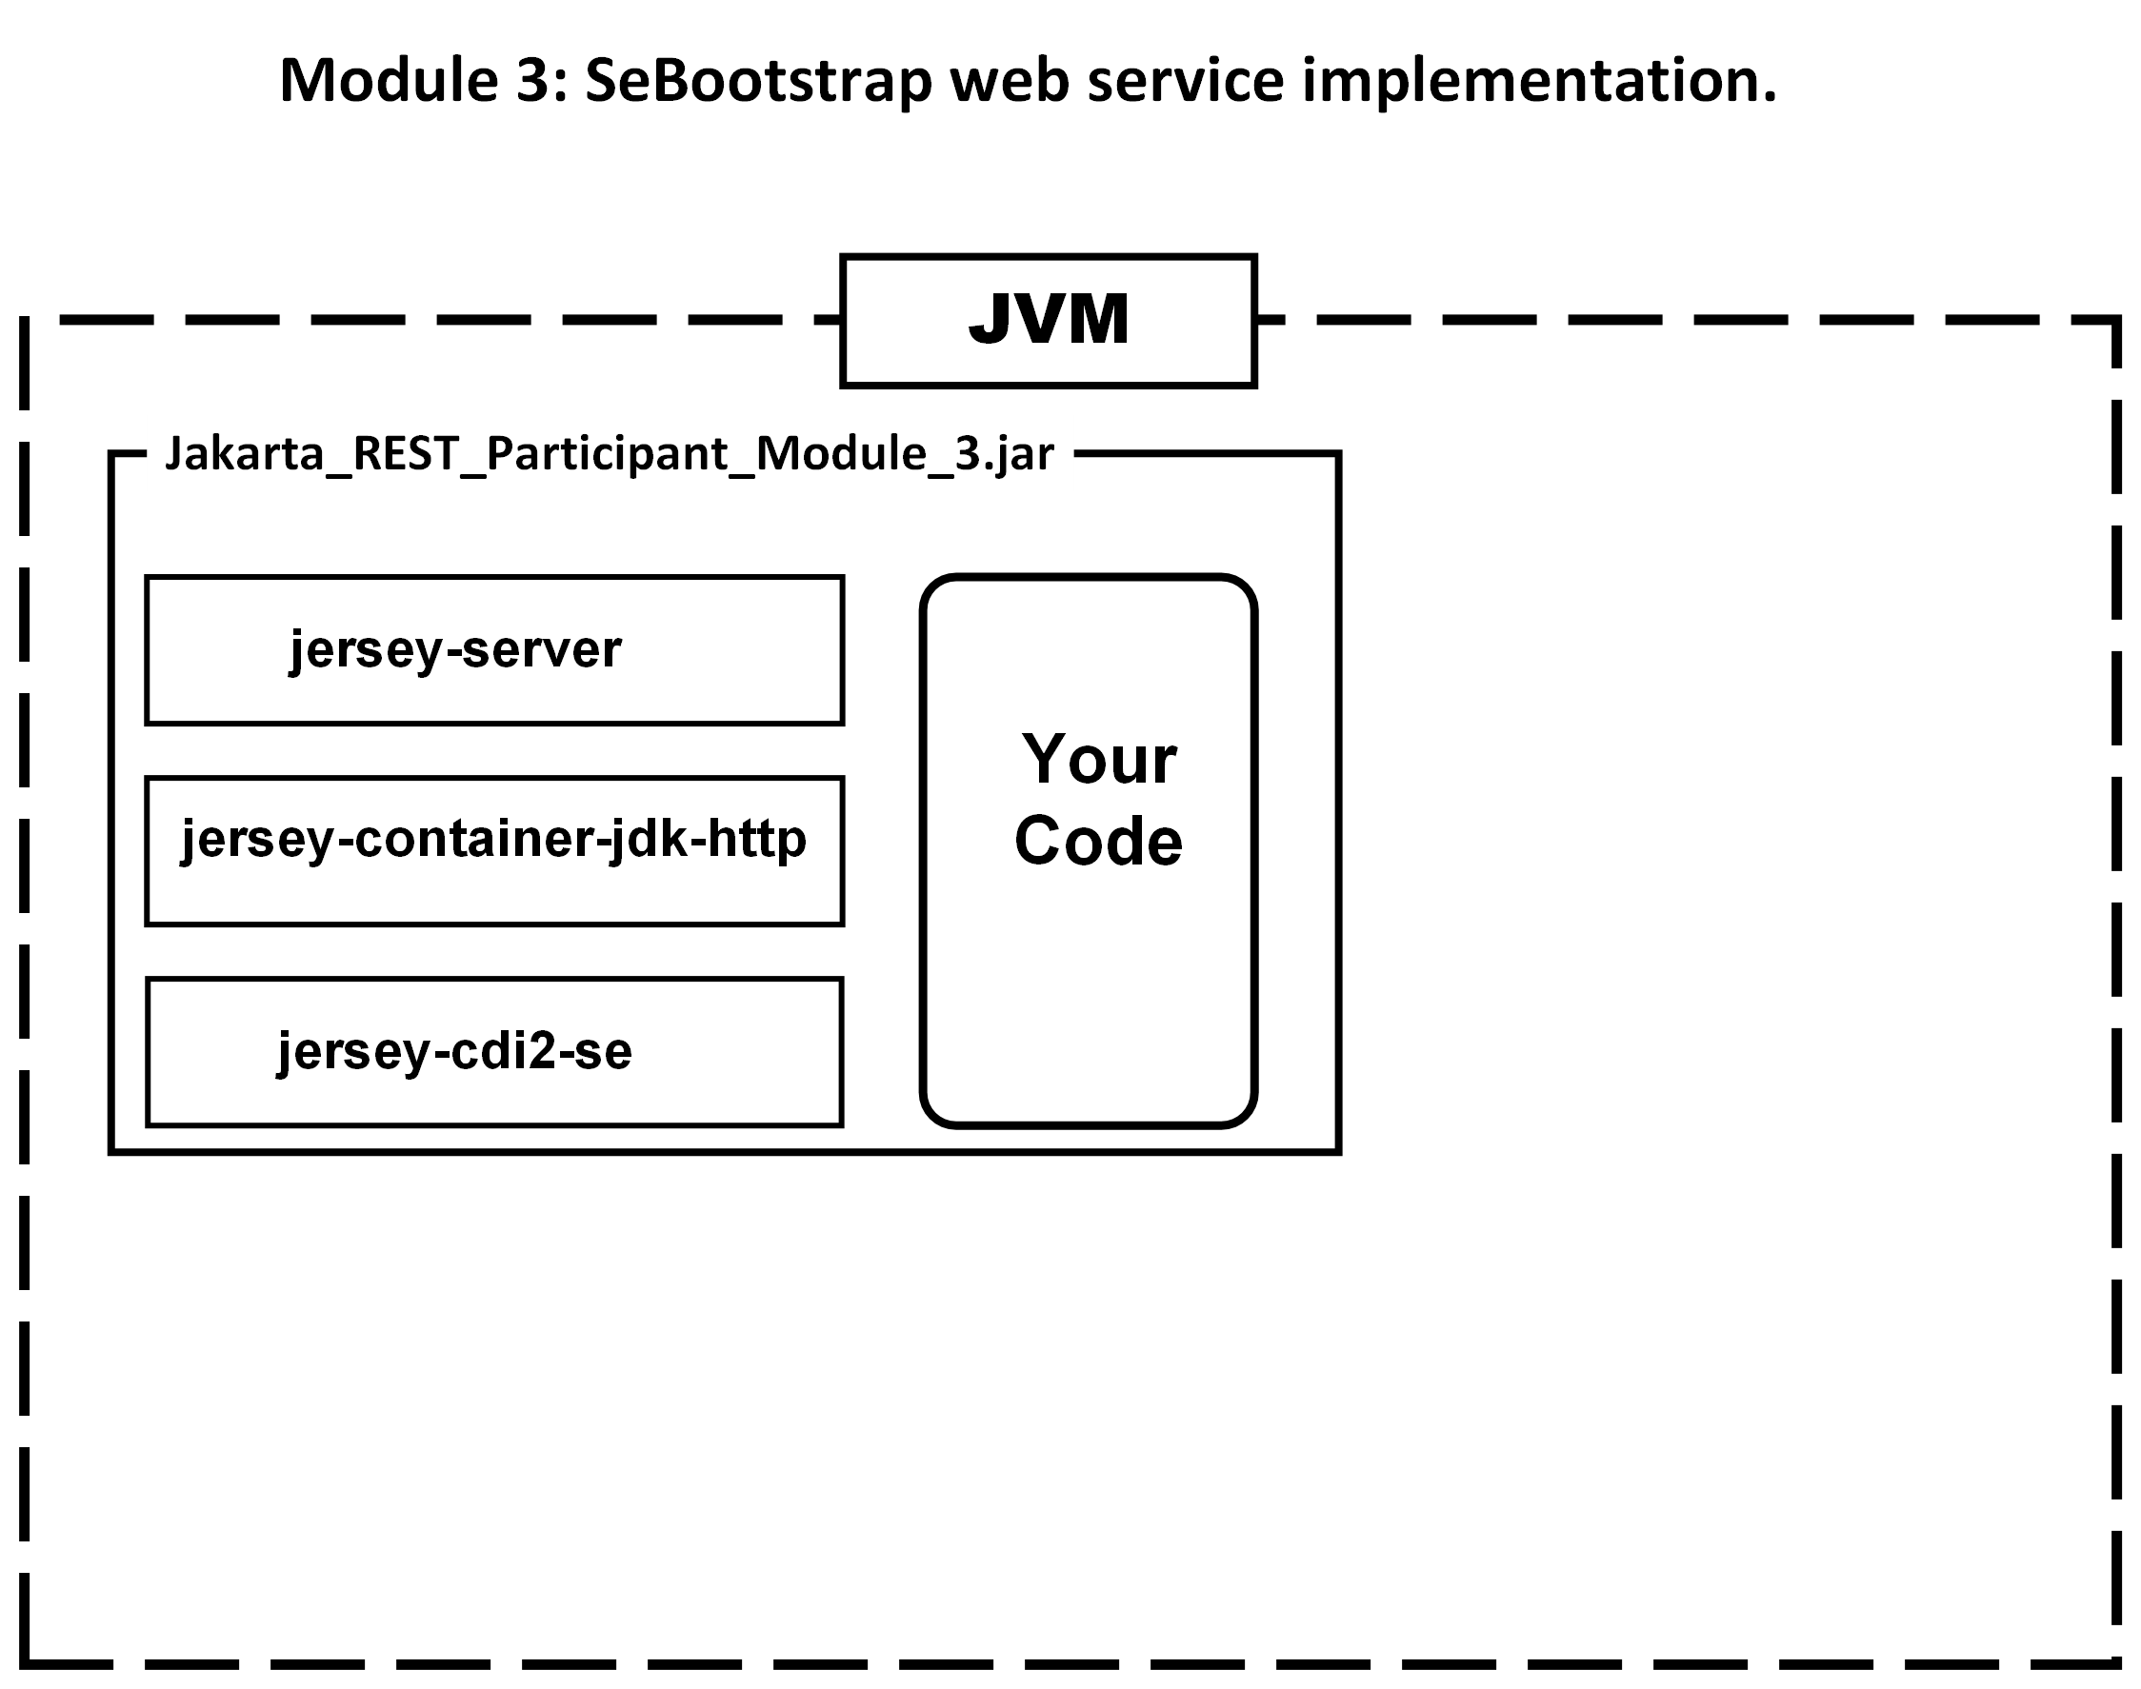

Slide 13
The task
Open the project mod_03_restsebootsrap_participant
This project implements a simple Greeting service
Review the files and run the project
Implement your own RESTful task or your completed CompoundInterest RESTful task

Slide 14
Se Bootstrap web service implementation
Web services can be standalone applications
An embedded server is required, such as Jersey or RESTEasy
There are three classes required:
The task class with annotations that define the code as a service
A class that extends Application and overrides the method getClasses that will return all service classes in the project
A class that configures the server to listen to a port for requests to the service

Slide 15
Jakarta RESTful Web Services 3.1 Workshop Module 4
Server based web service implementation

Slide 16
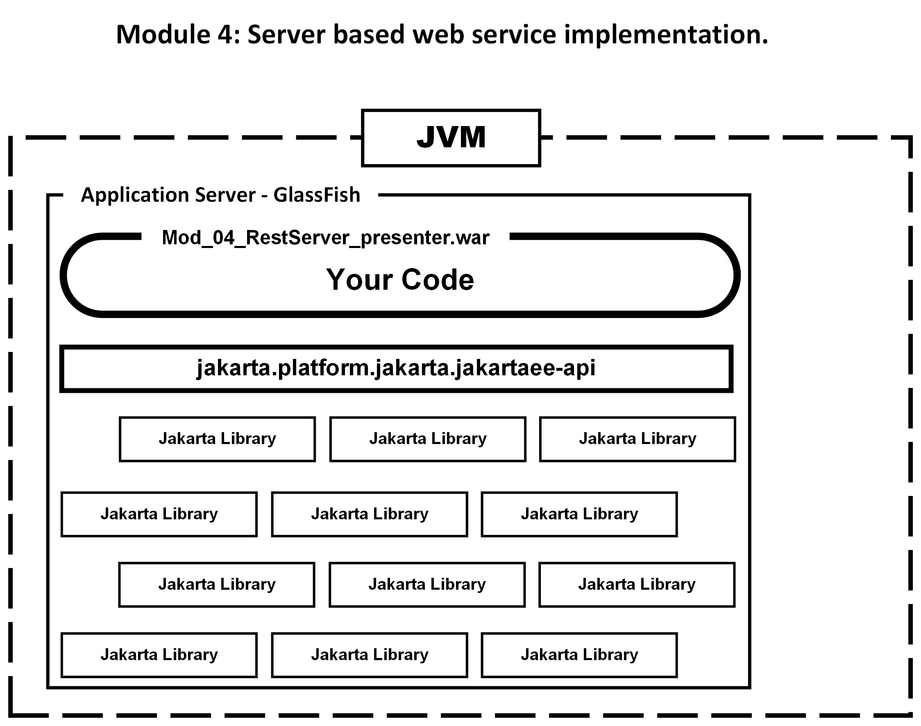

Slide 17
Server based web service implementation
Nothing could be simpler than when using an Application Server to host a service
Every possible library/framework that you might want to use is provided by the server
The result is that such a projects needs only one dependency
<dependencies>
<dependency>
<groupId>jakarta.platform</groupId>
<artifactId>jakarta.jakartaee-api</artifactId>
<version>${jakartaee-api.version}</version>
<scope>provided</scope>
</dependency>
</dependencies>

Slide 18
Jakarta RESTful Web Services 3.1 Workshop Module 5
Java SE/Desktop web services client

Slide 19
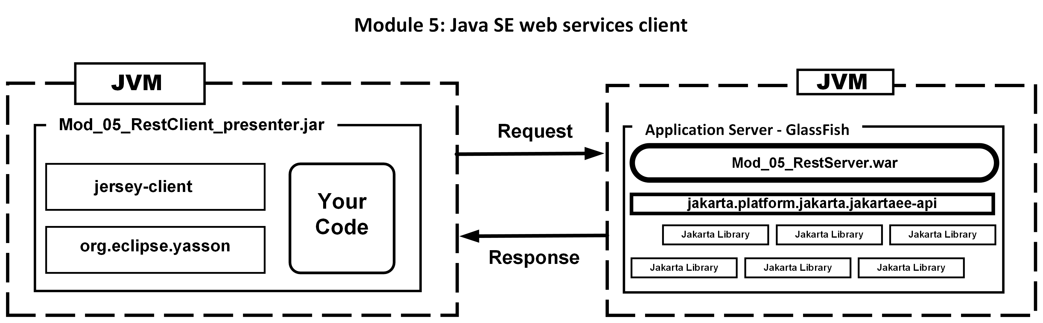

Slide 20
Java SE/Desktop web services client
Time to look at CLI web service clients
Fewer Maven dependencies
De-serialize a JSON string into an Object
We will see that client code is near identical in both a desktop and server-based projects

Slide 21
Jakarta RESTful Web Services 3.1 Workshop Module 6
Servlet and Jakarta Faces application server client

Slide 22
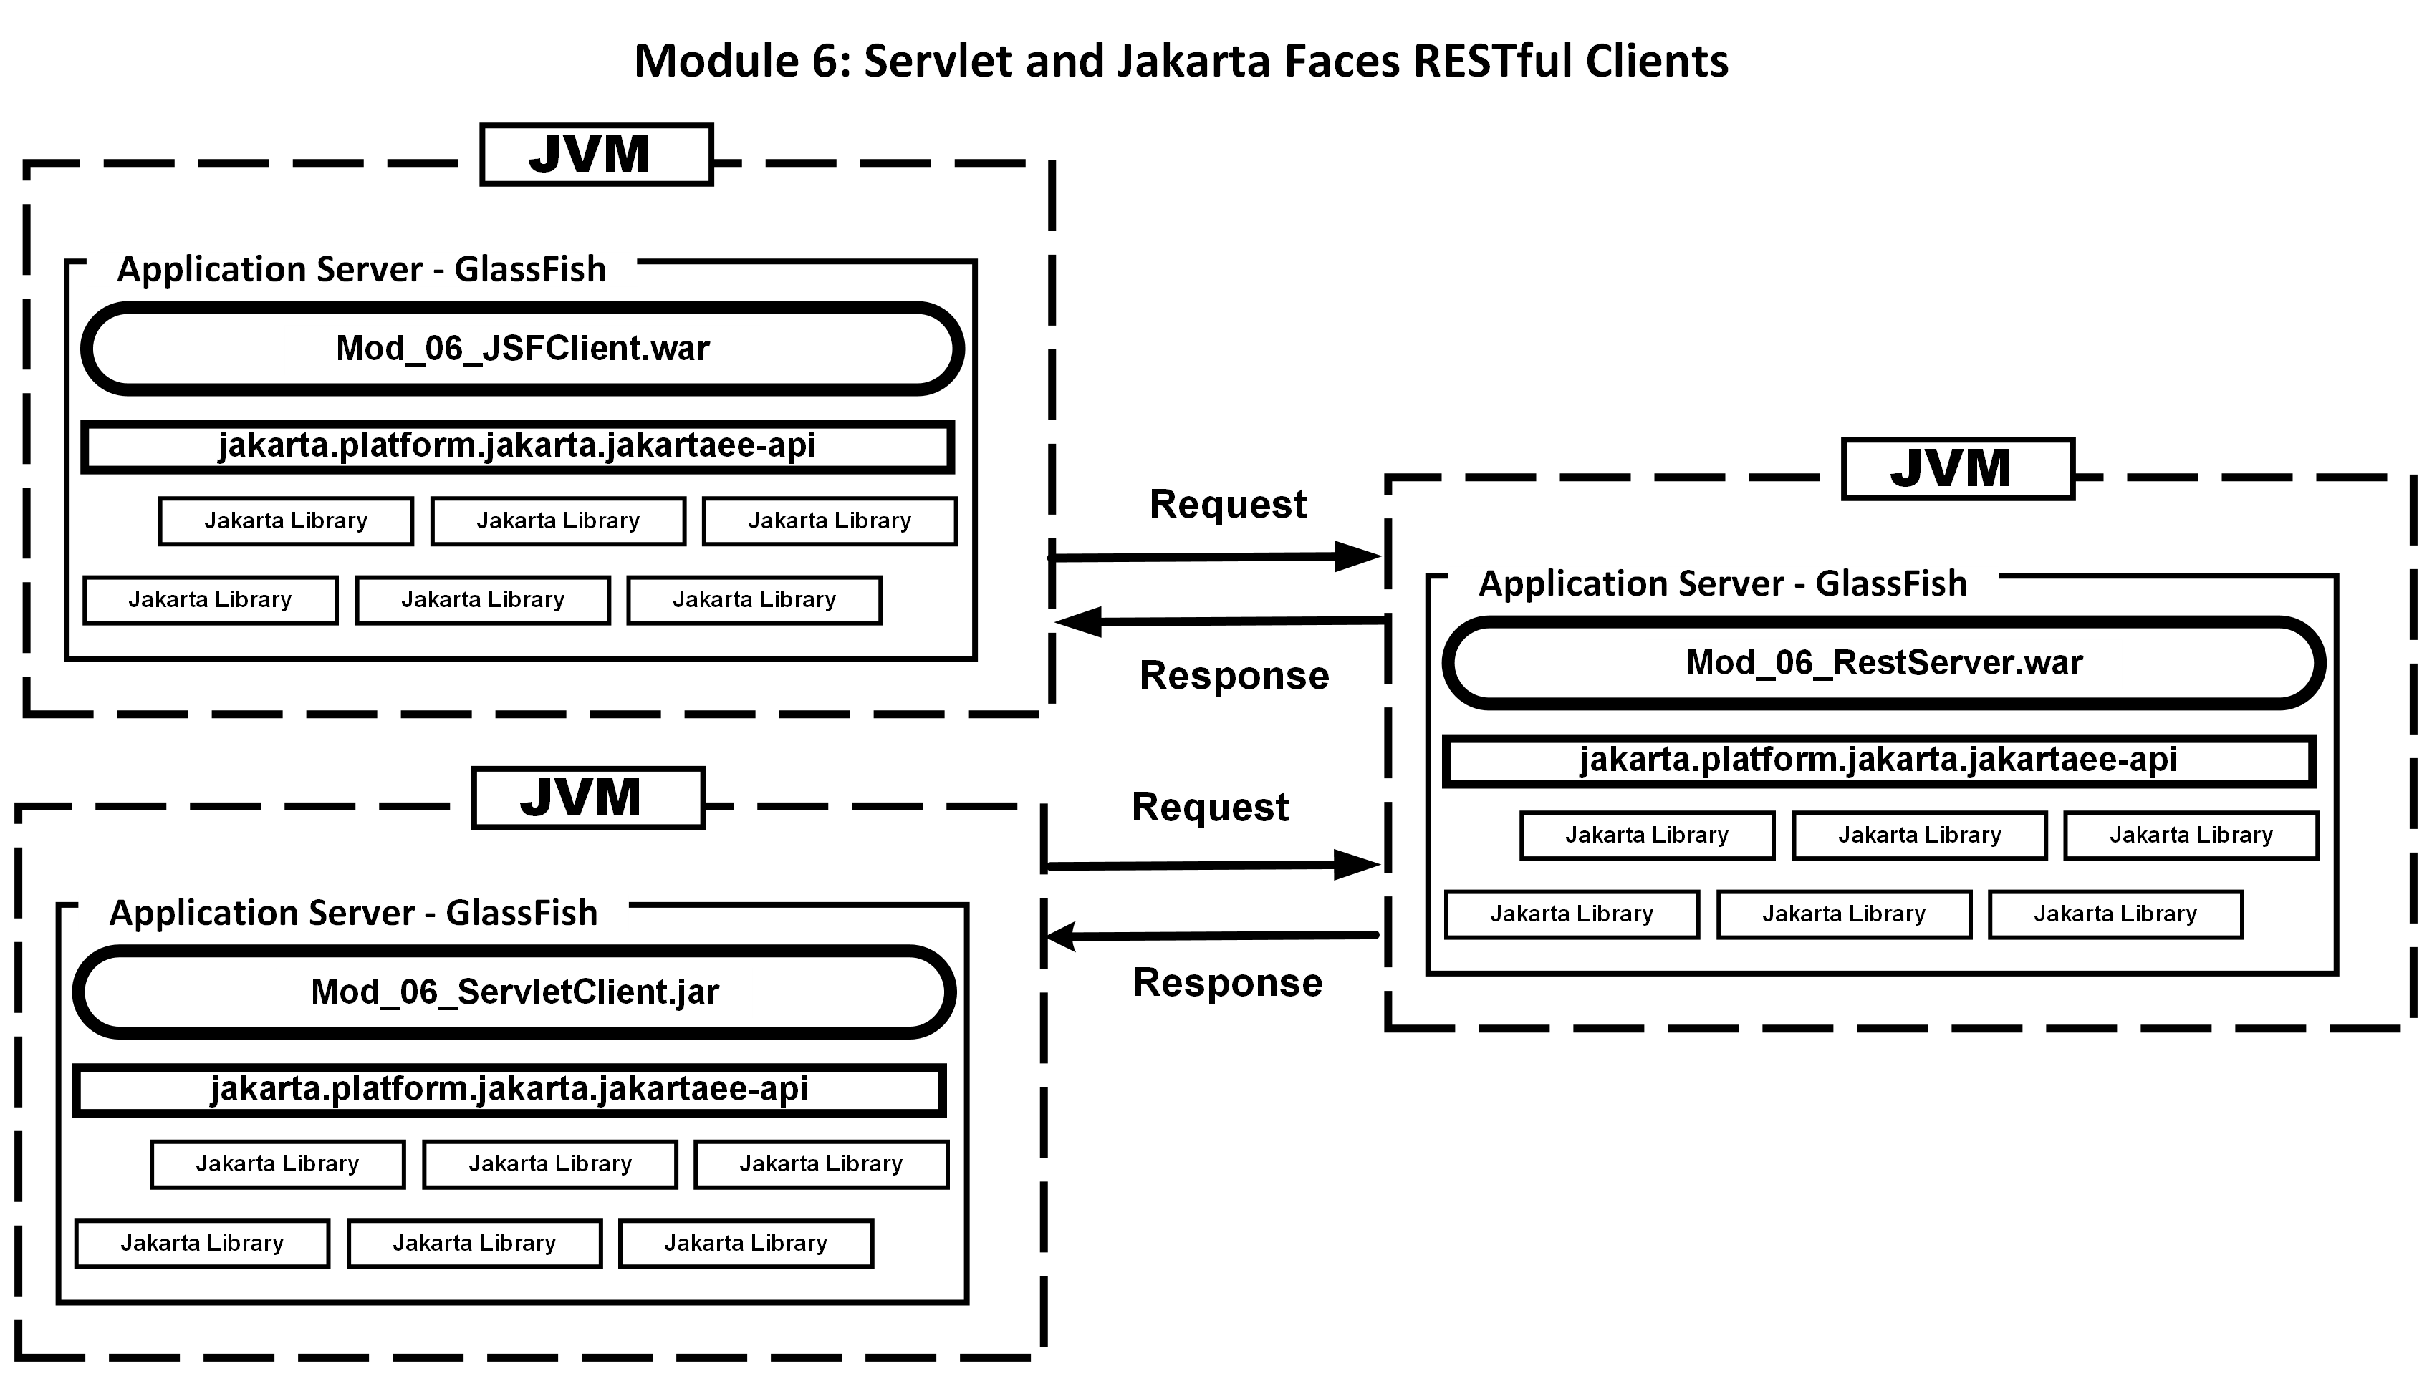

Slide 23
GlassFish server web services client
There are two clients in this module
Jakarta Faces
Servlet
The client code to access the service are near identical
The Jakarta Faces uses a POJO managed by CDI with the client code
The Servlet embeds the client code method in the Servlet

Slide 24
Jakarta RESTful Web Services 3.1 Workshop Module 7
MultiPart File Upload

Slide 25
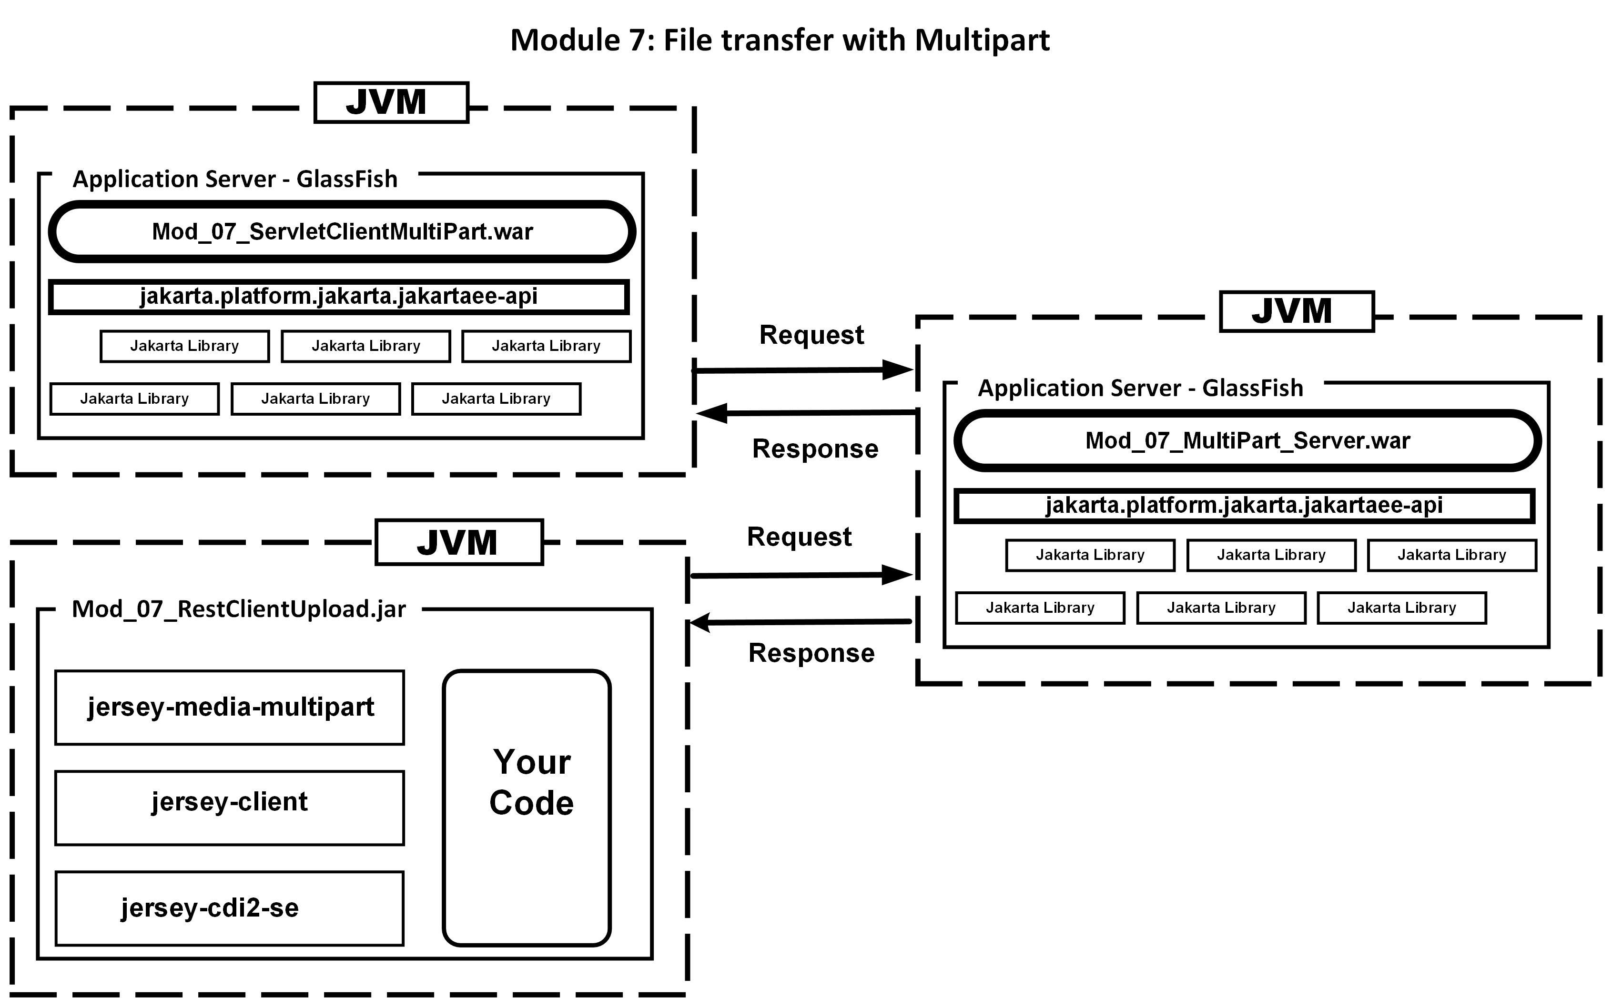

Slide 26
MultiPart File Upload
MultiPart allows you to upload or download binary files
In this module you will see a
mod_07_multipart_server_participant
mod_07_restclientupload_participant
mod_07_servletclientmultipart_participant
The multipart_server will receive an uploaded file and store it on your disk
The restclientupload is a desktop client that uploads a file
The servletclientmultipart is a Servlet client that uploads a file

Slide 27
Jakarta RESTful Web Services 3.1 Workshop Module 8
Jakarta Persistence 3.1 & RESTful Web Services 3.1

Slide 28
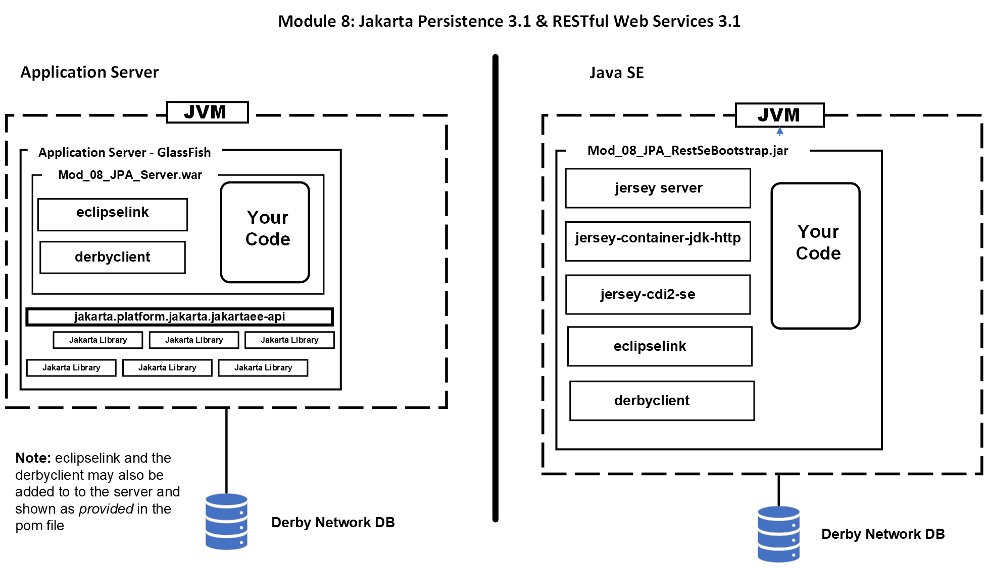

Slide 29
Jakarta Persistence 3.1 & RESTful Web Services 3.1
This module uses Jakarta Persistence to store a record to a database
The record consists of the compound interest data with a primary key
The database will be Derby
There are two servers:
Java SE desktop web service
mod_08_jpa_restsebootstrap_participant
GlassFish hosted web service
mod_08_jpa_server_participant

Slide 30
Jakarta RESTful Web Services 3.1 Workshop Module 8 Project
Jakarta Persistence 3.1 & RESTful Web Services 3.1

Slide 31
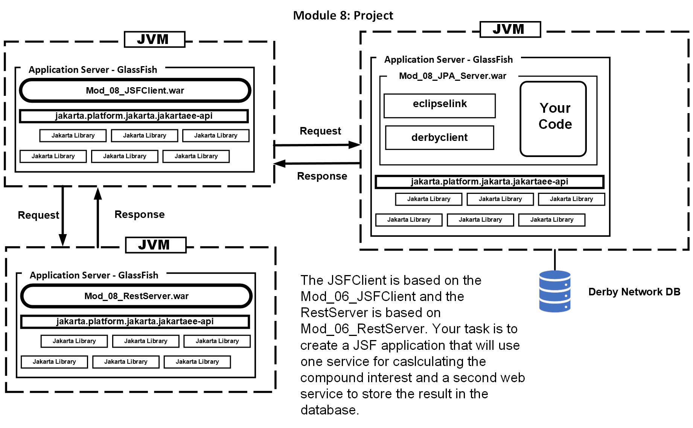

Slide 32



THANK YOU!
COPYRIGHT (C) 2023, ECLIPSE FOUNDATION. | THIS WORK IS LICENSED UNDER A CREATIVE COMMONS ATTRIBUTION 4.0 INTERNATIONAL LICENSE (CC BY 4.0)

